Slide 1

Statistics And Probability Fundamentals Basic Statistical Concepts, Measures

Slide 2

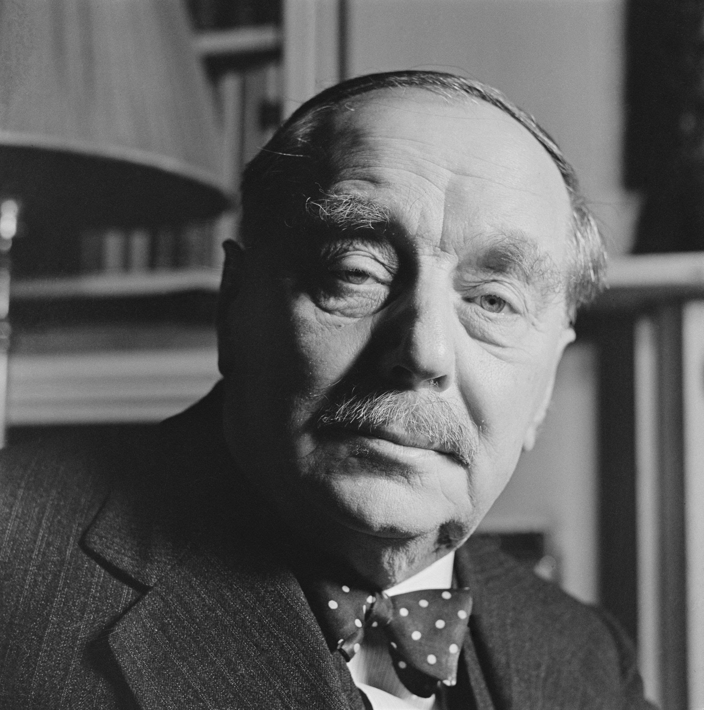

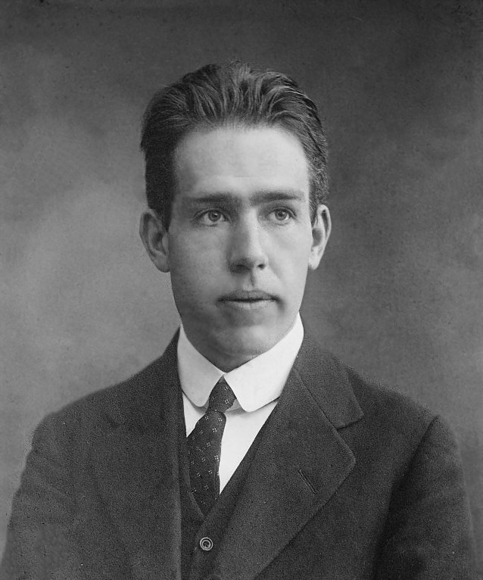
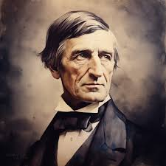
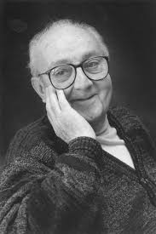
Statistical thinking will one day be as necessary a qualification for efficient citizenship as the ability to read and write.
– H.G. Wells.
Absence of evidence is not evidence of absence.
– Carl Sagan.
Prediction is very difficult, especially about the future.
– Niels Bohr.
All life is an experiment. The more experiments you make, the better.
–Ralph Waldo Emerson
The business of the statistician is to catalyze the scientific learning process.
– George Box.

Slide 3

INTENSE OF ANALYTICS
During World War II, the U.S. military wanted to protect their planes from getting shot down. They noticed that planes returning from combat had more bullet holes in the fuselage (the main body of the plane) and fewer in the engines. The officers thought they should add more armor to the areas with the most bullet holes.

Slide 4
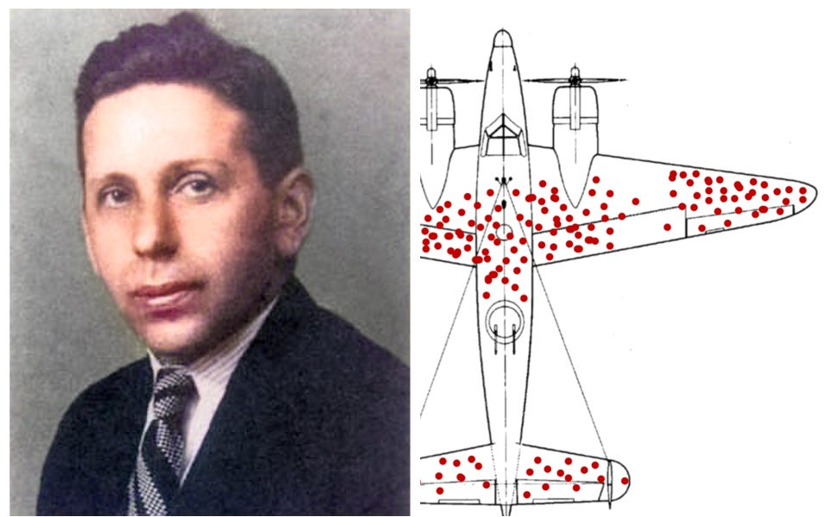
However, a brilliant mathematician named Abraham Wald thought differently. He realized that the planes with bullet holes in the engines weren’t coming back at all – they were crashing.
Section of plane | Bullet holes for square Feet
Engine | 1.11
Fuselage | 1.73
Fuel System | 1.55
Rest of the plane | 1.8
So, instead of adding armor where the bullet holes were, Wald suggested putting more armor where there were no bullet holes, especially on the engines. His idea was based on the fact that the planes that survived were hit in less critical areas.

Slide 5


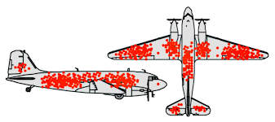
Wald’s insight saved many lives because it helped the military protect their planes more effectively. His work shows how looking at a problem differently, and questioning assumptions, can lead to better solutions.
This concept is called "survivorship bias," where we often only see the survivors of a situation and overlook those that didn’t make it, which can lead to wrong conclusions.
Wald's story teaches us the importance of thinking critically and not just focusing on the obvious, but also on what’s missing.

Slide 6
What Is Mathematics When It Is Useful ?
1.MATHEMATICS AS A LANGUAGE: It’s the language we use to make sense of the world, going beyond just numbers and equations.
2. FINDING PATTERNS AND CONNECTIONS: It helps us discover patterns, understand shapes, and see how different things are connected.
3. PROBLEM-SOLVING TOOLKIT: Mathematics provides tools to solve problems, from simple everyday tasks to complex challenges like space exploration.

Slide 7
What Is Mathematics When It Is Useful ?
4. CURIOSITY AND EXPLORATION: It drives us to ask questions, explore why things happen, and seek better solutions.
5. BUILDING AND PREDICTING: Mathematics is crucial for constructing stable structures, creating technology, and making economic predictions.
6. UNIVERSAL UTILITY: It’s not limited to scientists or engineers; it’s useful for anyone curious about how things work.

Slide 8
What Is Mathematics When It Is Useful ?
7. CLEAR THINKING AND DECISION-MAKING: Mathematics sharpens our ability to think logically, make informed decisions, and understand underlying structures.
8. DAILY LIFE APPLICATIONS: We use math daily, in activities like planning, cooking, managing relationships, and handling finances.
9. PERSPECTIVE ON THE WORLD: Mathematics offers a logical, structured way of viewing the world, helping us navigate life’s complexities and unlock new possibilities.

Slide 9
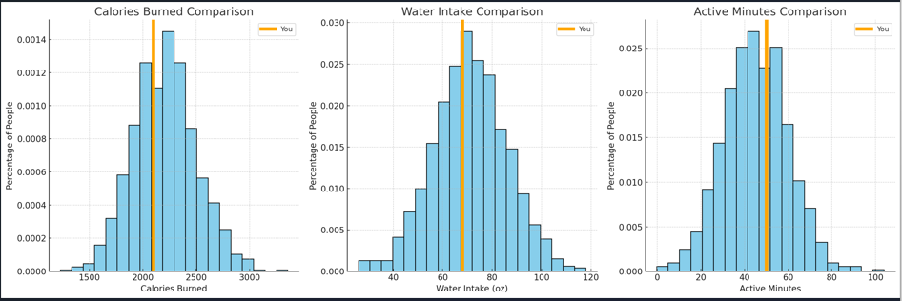
Data looks like This ?

Slide 10
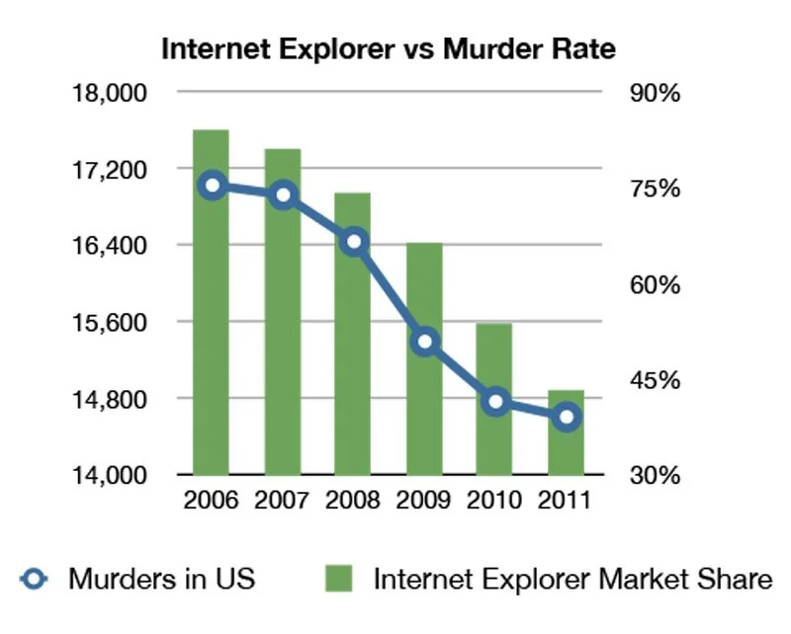
Misleading Graphs
Misleading Graphs: Not all graphs tell the truth; some are designed to twist the facts and mislead people.
Correlation vs. Causation: Misleading graphs can make unrelated things look connected, but just because two things happen together doesn’t mean one causes the other.
Deceptive Practices: Graphs, especially in politics, are often manipulated to influence opinions and results.
Humorous Example: Using a funny example, like connecting unrelated things in a graph, makes the lesson more enjoyable and easier to understand.
Critical Thinking: The advises being careful and smart when analyzing graphs, as not all of them are honest or accurate.

Slide 11
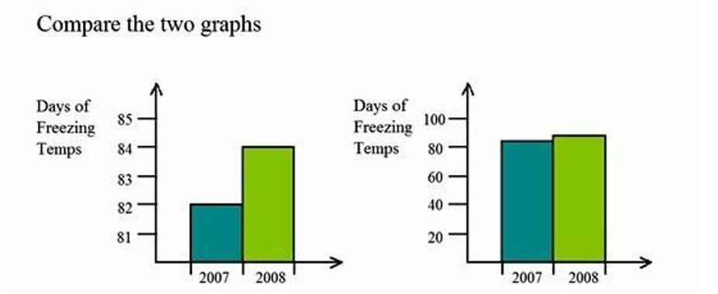
Misleading Graphs
The graph on the left misleads by using a truncated Y-axis that starts at 81, exaggerating the difference between 2007 and 2008.
In contrast, the graph on the right uses a full Y-axis starting from 0, accurately reflecting the true difference. This demonstrates how altering the scale can distort perceptions of data changes.

Slide 12
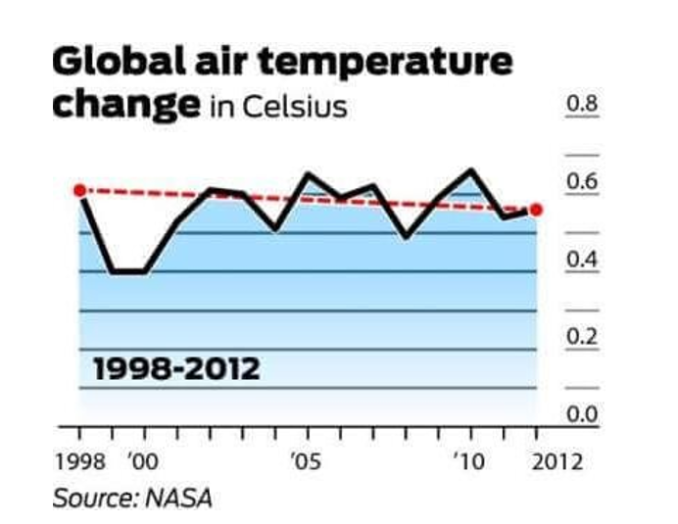
Misleading Graphs

Slide 13
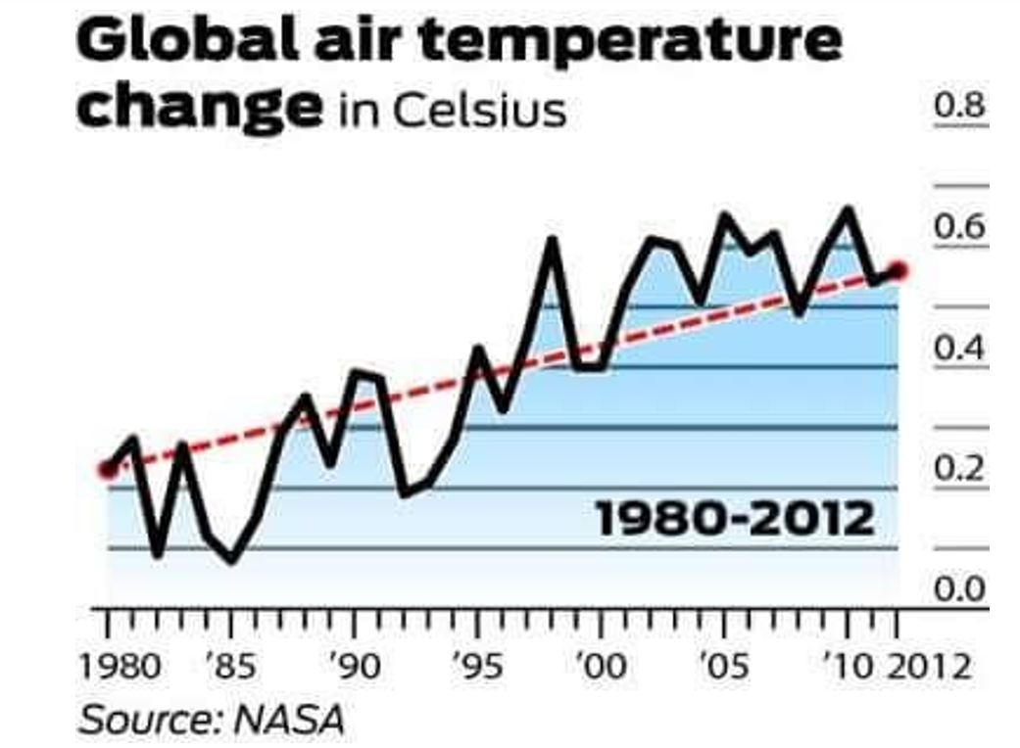
Misleading Graphs

Slide 14
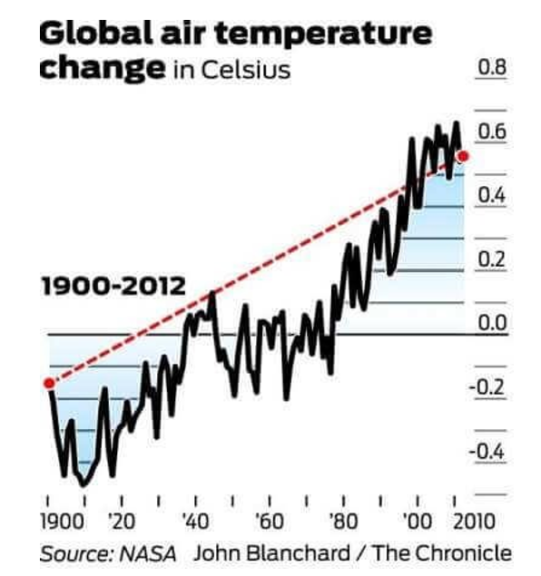
Misleading Graphs

Slide 15

Correlation vs Causation
Eating breakfast might help in fighting obesity by jumpstarting your metabolism early in the day. Starting your day with a healthy meal can keep your energy levels steady and reduce overeating later. It also helps prevent unhealthy snacking, which can contribute to weight gain.
Studies suggest that people who eat breakfast are more likely to maintain a healthy weight. Skipping breakfast often leads to consuming more calories later in the day, which can contribute to obesity. A balanced breakfast keeps you fuller for longer, making it easier to resist junk food.
Choosing the right breakfast is key—focus on whole grains, fruits, and proteins to stay satisfied. Avoid sugary cereals and pastries, which can cause energy spikes and crashes. A nutritious breakfast supports overall health and can be a powerful tool in managing weight.

Slide 16



The Cholesterol Confusion

Slide 17


Slide 18
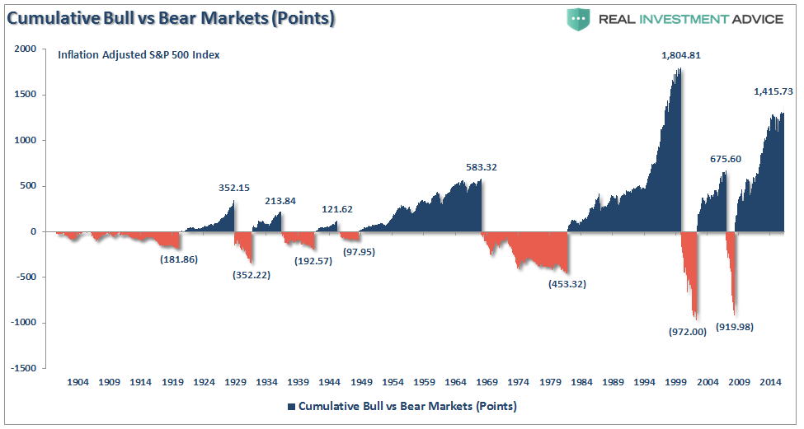
costliest mistakes stock market investors make (because of misleading graphs)
Falling for Truncated Axes: When bar graphs don’t start the y-axis at zero, small changes can look much bigger than they really are, misleading investors about a company’s growth.
Getting Fooled by Circle Sizes: If circles in graphs are sized by diameter instead of area, it can make companies seem much more valuable than they are, leading to wrong investment decisions.
Not Noticing Scale Tricks: Some graphs change the scale to make trends or comparisons look more dramatic, which can trick investors into making bad choices based on exaggerated data.

Slide 19
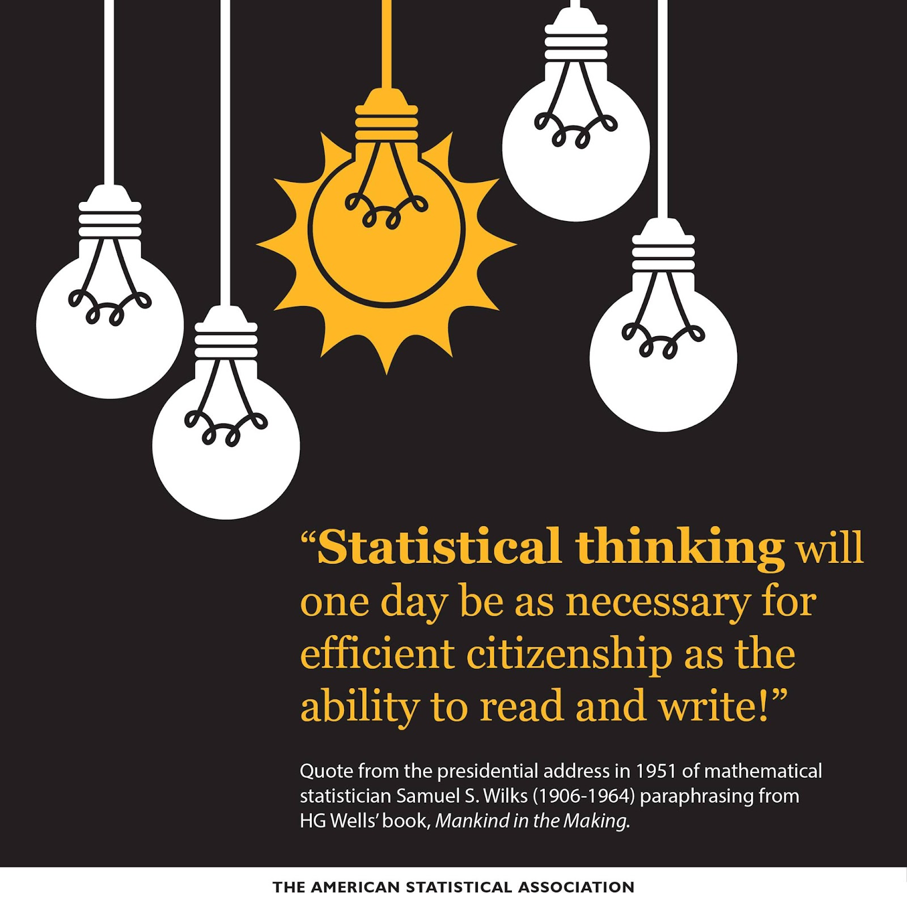
Essential Mathematical and Statistical Literacy
Need for Foundation: Strong math and statistics knowledge is crucial for success in a data-focused world.
Math Skills: Being good with math and statistics is essential in today’s world.
Accurate Data Use: Understanding data correctly is key to making smart decisions in life.
Risks of Misinterpretation: Incorrectly reading data can result in poor and potentially harmful choices.

Slide 20


Bad Samples :
Example:
“This pizza is everyone’s favorite in town!”
Issue:
If the sample was taken only from people at a pizza festival, it wouldn’t represent everyone in town.

Slide 21


Small Samples
Example:
"My friend’s three kids all love this cartoon, so it must be the best for all children."
Issue:
Just three kids isn’t enough to conclude that all children would love the cartoon.

Slide 22


Detached Statistics
Example:
"This shampoo makes your hair 20% shinier!"
Issue:
Without saying compared to what—no shampoo, another brand, or just water—this claim is vague and potentially misleading's love the cartoon.

Slide 23
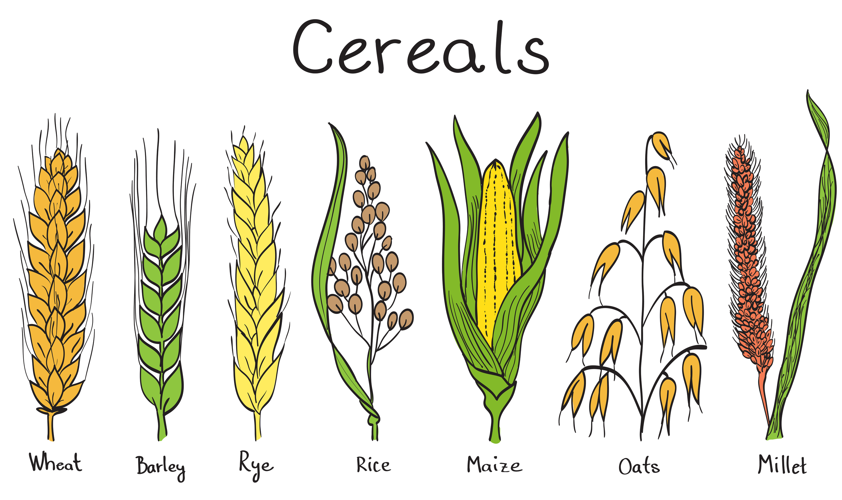
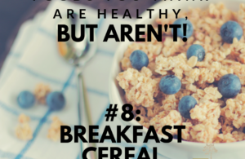
Poor Definition
Example:
"This cereal is 25% healthier!"
Issue:
The term "healthier" isn’t clearly defined. Is it less sugar, more Fiber, or something else?

Slide 24
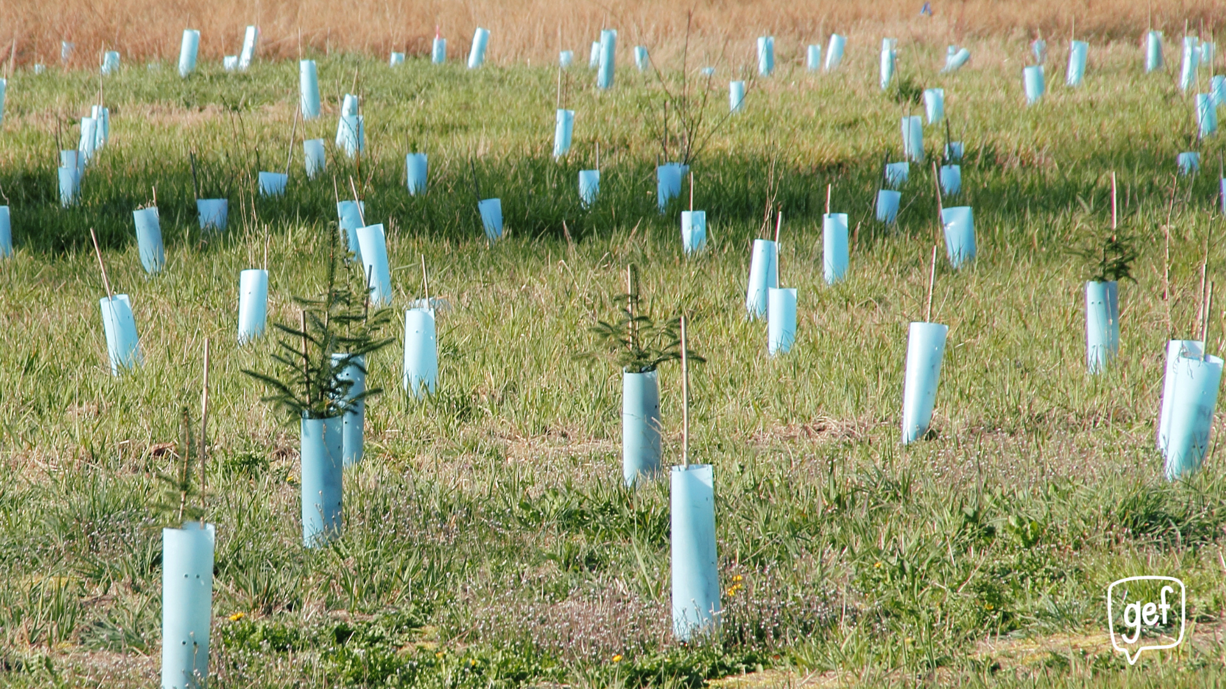

Changing the Subject
Example:
"Under my leadership, we planted 1,000 trees."
Issue:
This sounds impressive, but if the focus should be on reducing pollution instead of tree planting, it could be misleading.

Slide 25

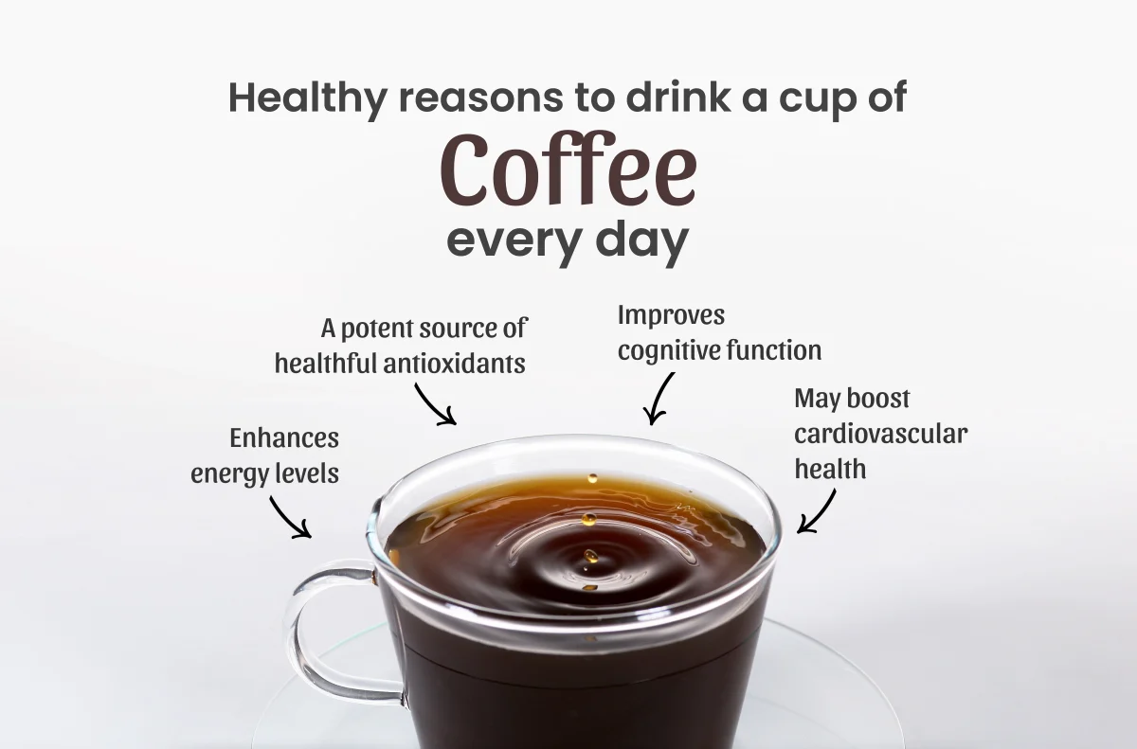
Semi-Attached Figure (Implied Connections)
Example:
"Most successful entrepreneurs drink coffee every morning."
Issue:
This statement suggests that drinking coffee leads to success, but there’s no proof that one causes the other.

Slide 26


Loaded Questions or Leading Questions
Example:
"Don’t you think it’s unfair that some students get extra help from tutors?"
Issue:
The question is worded in a way that makes people more likely to agree, even if they might not think it’s unfair.

Slide 27
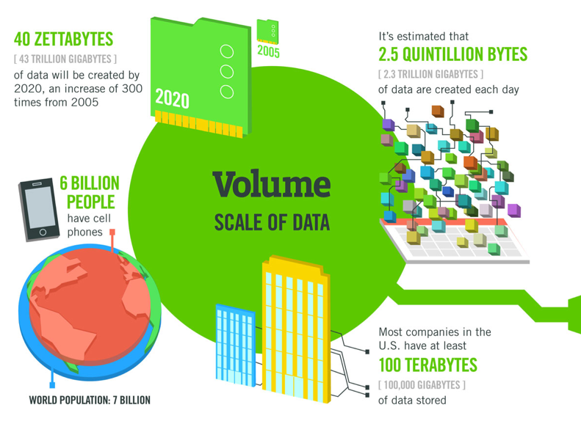
Overwhelming Volume of Data
Importance of Data Management: Properly managing this data is essential for gaining valuable insights.
Data Explosion: We generate vast amounts of data at a faster rate than ever before.
Digital Footprints: Every online action contributes to the growing pool of data.
Big Data Tools: Advanced tools are needed to process and interpret the vast quantities of data.

Slide 28

Contradictory and Ambiguous Evidence
Conflicting Data: Multiple sources can offer contradictory conclusions, leading to confusion.
Need for Critical Thinking: It's crucial to think critically to navigate through conflicting data and uncover the truth.
Paradox of Plenty: Having more information can sometimes result in less clarity and certainty.

Slide 29
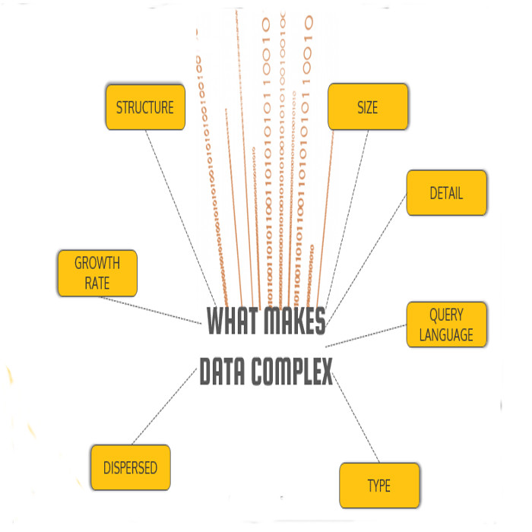
Complexity in Making Sense of Data
Expertise Required: Knowing statistics and data science is crucial to get useful insights from data.
Data Formats: Data comes in different types—structured, semi-structured, and unstructured—making it complicated to analyze.
Analysis Needs: To understand relationships and patterns, you need thorough and detailed analysis.
Context Matters: How data is presented can change how it is understood and interpreted.

Slide 30
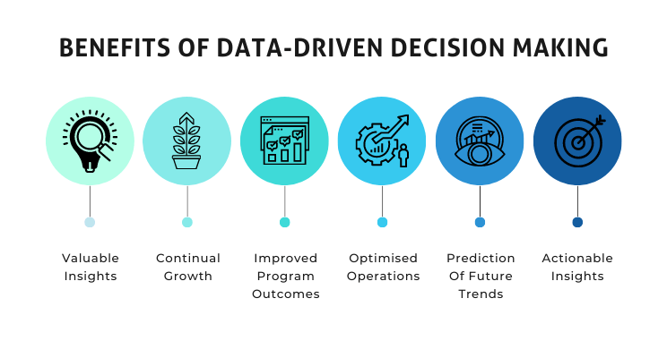
The Role of Data in Decision-Making
Importance of Evaluation: Being able to critically assess data is vital for making good decisions.
Data's Role: Data is essential for making decisions in various industries and fields.
Widespread Reliance: Businesses, governments, and people use data to guide their choices.
Consequences of Misuse: Misusing or misreading data can lead to serious, often negative, outcomes.

Slide 31
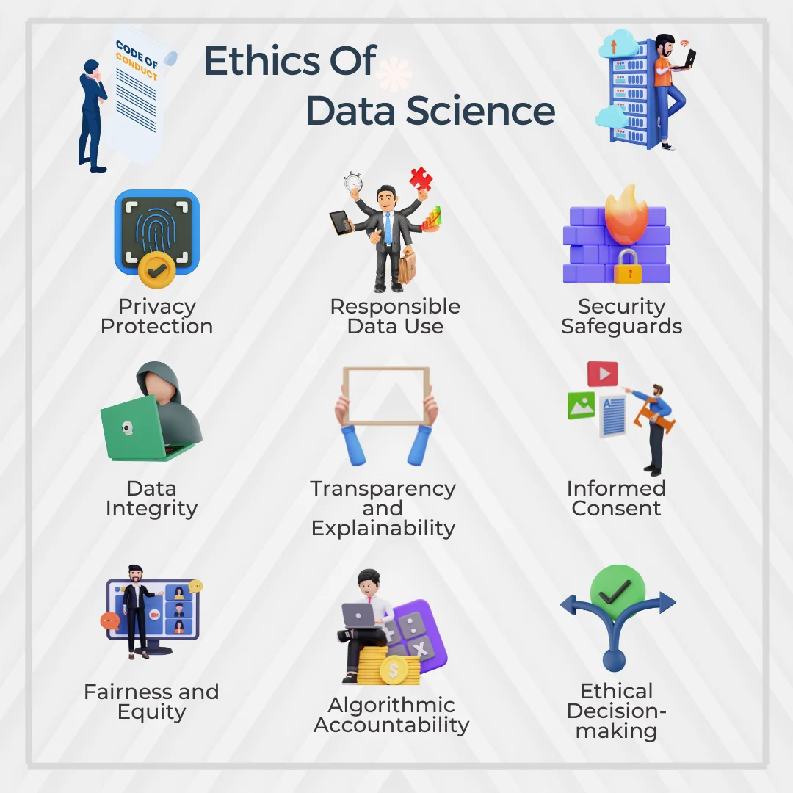
Ethical Considerations in Data Use
Responsible Use: Following ethical standards ensures data is used fairly and responsibly.
Ethical Concerns: Using data brings up important issues about privacy, security, and fairness.
Risks of Misuse: Misusing data can have serious consequences, stressing the need for ethical guidelines.
Need for Ethics: As data plays a bigger role in our lives, understanding and following ethical practices is crucial.

Slide 32

Catching Statistical Errors
Question the Source - Who Says So?
Credibility Matters:
Always consider the source of the statistical claim.
Is it from a reputable organization, academic research, or an expert in the field?
Or is it from a source with potential bias, like marketing teams or interest groups?
Bias and Intent:
Understand the potential biases of the source.
Could the source have a vested interest in presenting data in a certain way?
Is the data being used to support a specific agenda?
Peer Review and Transparency:
Check if the data or study has undergone peer review.
Transparency in methodology and data collection enhances credibility.

Slide 33
Catching Statistical Errors
Verify the Methodology - How Do They Know?
Examine Data Collection:
Scrutinize how the data was collected.
Was it through surveys, experiments, or observational studies?
Different methods have varying degrees of reliability.
Understand the Process:
Dive into the methodology.
How were variables defined and measured?
Were controls in place to reduce bias?
Replication and Consistency:
Check if similar results have been replicated by other studies or sources.
Consistent findings across multiple studies strengthen the validity of the claim.

Slide 34
Catching Statistical Errors
Be Aware of Data Presentation - Watch Out for Stated & Unstated Data
Inclusion and Exclusion:
Pay attention to what data is included and, more importantly, what is excluded.
Sometimes, crucial data is left out to shape a narrative.
Context Matters:
Consider the context in which data is presented.
Are there underlying factors or additional data points that could change the interpretation?
Selective Reporting:
Be cautious of cherry-picked data that only highlights favorable results.
Full transparency is key to understanding the complete picture.

Slide 35
Catching Statistical Errors
Evaluate the Sample Size - Is the Sample Large Enough?
Sample Size and Representation:
A small sample size may not represent the larger population, leading to unreliable conclusions.
Ensure the sample is large enough to be statistically significant.
Sampling Bias:
Assess whether the sample was randomly selected.
Determine if it adequately represents the demographics of the larger population.
Non-random sampling can introduce bias.
Margin of Error and Confidence:
Larger sample sizes typically reduce the margin of error, leading to more reliable results.
Always consider the confidence level of the statistics presented.

Slide 36
Catching Statistical Errors
Check for Logical Consistency - Does It Make Sense?
Logical Flow:
Ensure that the data supports the conclusions drawn.
Sometimes, data is presented in a way that doesn't logically lead to the stated conclusions.
Cause vs. Correlation:
Distinguish between correlation and causation.
Just because two variables are correlated doesn’t mean one causes the other.
Be wary of oversimplified conclusions.
Critical Thinking:
Apply common sense and critical thinking.
If something seems too good (or bad) to be true, it’s worth digging deeper.
Ask yourself if the results align with what you know about the world.

Slide 37

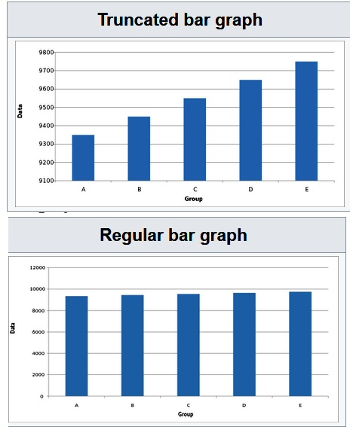
Truncated Bar Graph
5 Costliest Mistakes Stock Market Investors Make (Because Of Misleading Graphs)
A truncated bar graph is a type of bar chart where the baseline is moved up or down to make the differences between the bars more visually apparent.
This technique is often used to highlight small differences between data points that might not be as noticeable on a standard bar graph.
Truncating the graph can sometimes be misleading because it can exaggerate the perceived differences between the values.

Slide 38
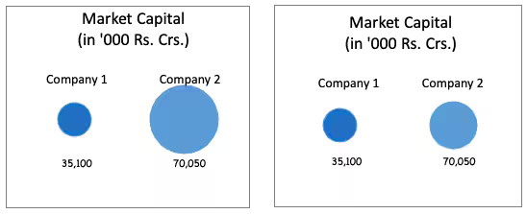
Circle For Value
A "circle for value" bar graph, often referred to as a circle chart, is a variation of a bar chart where each data point is represented by a circle instead of a traditional bar.
It is common to represent the market capitalization of different companies using circles of varying sizes in financial reports.
This approach allows viewers to quickly compare market caps across multiple companies.

Slide 39
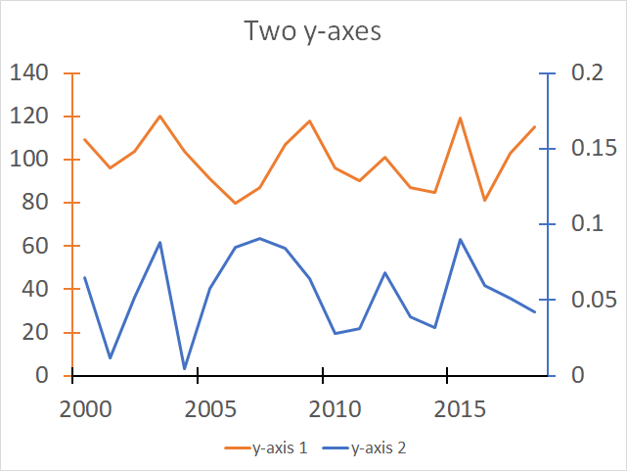
Dual Axis Graphs For Correlation
Dual axis graphs are powerful tools used to display and analyze relationships between two sets of data that have different scales or units.
They allow for the comparison of two variables that may not be easily represented on a single axis.

Slide 40

Deflated Currency
Many graphs depicting changes in stock or commodity values over time, as well as those showing company revenues or profits, use trend lines to illustrate growth.
These lines typically slope upwards, suggesting significant increases in value and a positive outlook.
However, a critical aspect often missing from these graphs is the adjustment for inflation, which affects the real value of money.

Slide 41
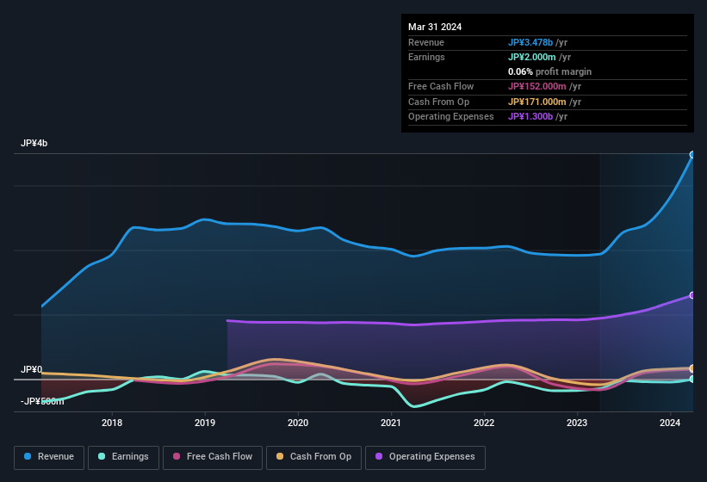
The Ubiquitous Stock Chart
Many online financial portals display stock charts that illustrate the fluctuations in a company's share price over time.
These charts are useful for current shareholders evaluating the performance of their investments. However, they can be misleading for prospective investors.
Stock prices can be affected by short-term factors such as market sentiment, news events, or changes in the number of outstanding shares.

Slide 42
The Power Of Statistics

Slide 43
Unlocking Insights with Statistics
Statistics transforms raw data into actionable insights, enabling data-driven decision-making. By gathering, understanding, analyzing, and presenting data, it uncovers hidden patterns and informs decisions. This presentation explores these stages to demonstrate how statistics drive impactful actions.
1.Data Gathering 2.Data Understanding.
3.Data Analysis & Interpretation 4.Data Presentation

Slide 44
The Foundation: Data Gathering
OBJECTIVE: Our goal is to collect data that is accurate, relevant, and comprehensive, sourced from reliable origins.
IMPORTANCE: Remember, the quality of our insight’s hinges on the quality of the data we collect. Without high-quality data, our analysis and conclusions are at risk.
KEY STEPS:
Define the Data Requirements: Clearly outline what data is needed for your analysis.
Identify and Access Data Sources: Locate and obtain data from reliable and relevant sources.
Ensure Data Accuracy and Completeness: Validate that the data is both precise and complete to avoid errors in your findings.
IMPACT: Effective data gathering is crucial. It establishes a strong foundation for analysis, ensuring that every step that follows is based on solid and reliable data.

Slide 45
Decoding the Dataset: Data Understanding
OBJECTIVE: Our aim is to explore and profile the collected data to uncover patterns, trends, and anomalies.
IMPORTANCE: Understanding the data is essential for accurate analysis. It helps prevent misinterpretations and ensures the reliability of our conclusions.
KEY STEPS:
Data Profiling: Summarize the key characteristics of the data to understand its structure and content.
Exploratory Data Analysis (EDA): Use visualizations to examine data distributions, correlations, and identify outliers.
Identify Missing or Inconsistent Data: Detect any gaps or inconsistencies in the dataset that need addressing.
IMPACT: A thorough understanding of the data ensures that our analysis is grounded in accurate assumptions, leading to more reliable and actionable insights.

Slide 46
Turning Data into Insights: Analysis & Interpretation
Objective: Our goal here is to apply statistical techniques to extract meaningful patterns and trends from the data we've gathered.
Importance: This stage is where we transform raw data into actionable insights. It's crucial because these insights will drive our decisions and strategies.
Key Steps:
Choose Appropriate Statistical Methods: Select suitable techniques such as regression or clustering based on our data and objectives.
Analyze Data: Dive into the data to uncover trends, correlations, and causations that reveal how variables are related.
Interpret Results: Relate the findings back to the problem or business objective to ensure our insights are relevant and actionable.
Impact: Effective analysis and interpretation empower organizations to make informed, data-driven decisions. This process can significantly impact outcomes and drive success.

Slide 47
Communicating Insights: Data Presentation
Objective: Our aim is to present the analyzed data in a clear, concise, and visually engaging way.
Importance: Effective presentation is crucial because it transforms complex data into understandable insights that can be easily acted upon.
Key Steps:
Choose the Right Visualization Tools: Select appropriate tools such as charts, graphs, or dashboards to best represent the data.
Simplify Complex Data: Break down complex information into digestible formats that are easy to understand.
Tailor Presentations to the Audience: Adapt the presentation to suit the audience’s level of understanding to ensure the insights are effectively communicated.
Impact: Clear data presentation ensures that insights are not only understood but also inspire action. This makes data-driven strategies actionable and impactful.

Slide 48

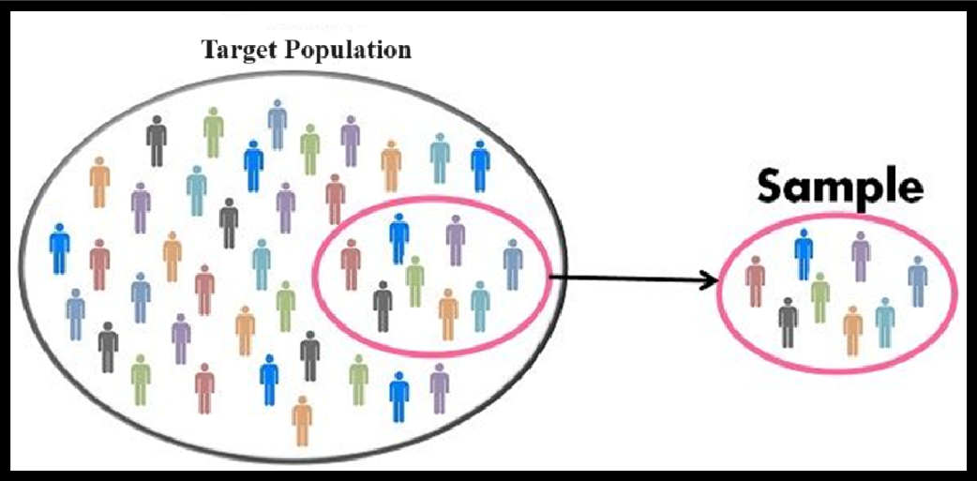
Population and Sample

Slide 49

Census
Definition: A census collects data from everyone in a specific population.
Examples: Includes national elections, decennial censuses, and detailed surveys.
Complete Data: Provides information on every individual, giving the most accurate results.
Cost and Time: It can be expensive and time-consuming but delivers the most thorough insights

Slide 50

Definition: Sampling collects data from a smaller group to make inferences about a larger population.
Examples: Includes opinion polls and quality checks in manufacturing.
Cost and Speed: It's cheaper and quicker than a full census.
Accuracy: Uses statistical methods to ensure the sample represents the whole population well.

Slide 51
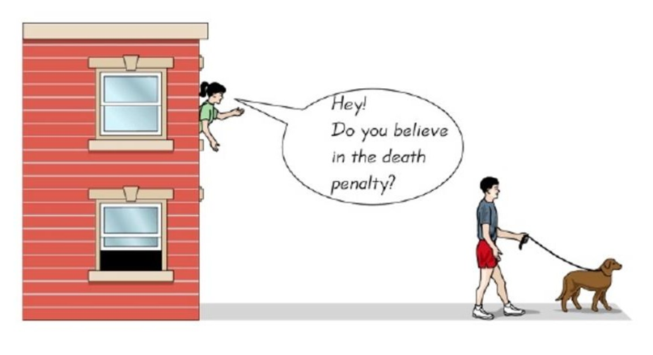
Data Gathering - Sampling Techniques
Convenience Sampling
Eg: online polls, Asking your best friend etc,

Slide 52
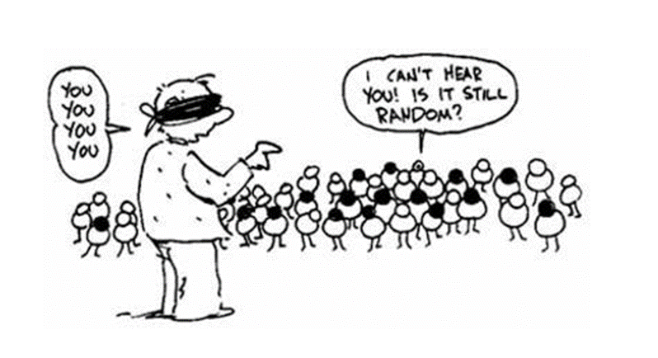
Random Sampling
Data Gathering - Sampling Techniques
Each member has an equal chance of being selected

Slide 53
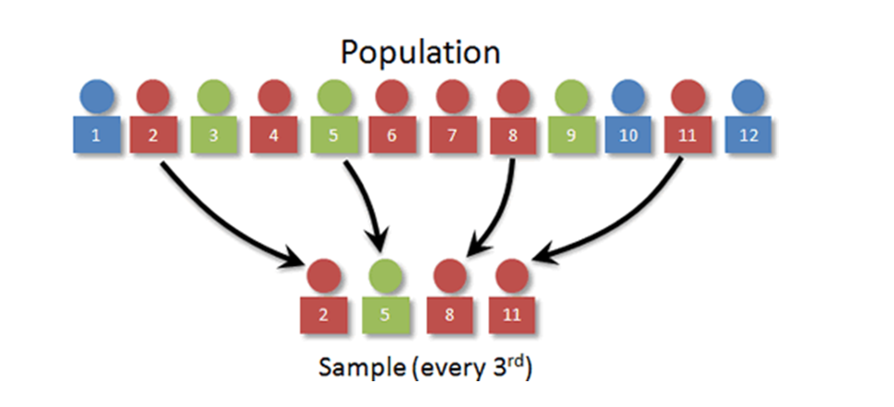
Systematic Random Sampling
Sampling Techniques
Examples: Supermarket chooses every 10th and 15th customer entering the supermarket and conduct the survey

Slide 54
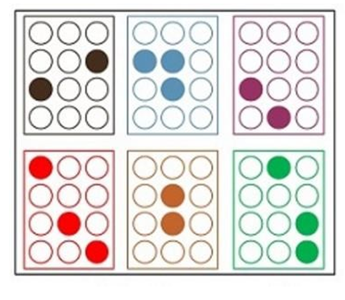
Sampling Techniques
Stratified Techniques
- Divide the data into several relevant strata and then sample from each data
E.g. For getting an opinion on demonetization , one choice of strata might be state-wise analysis. we get 20 random volunteers from each and every state

Slide 55

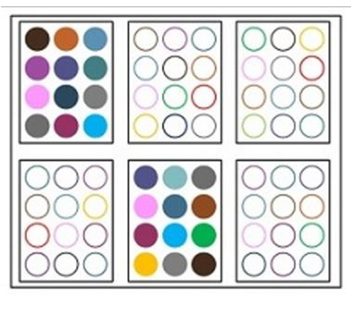
Sampling Techniques
Cluster Sampling
-Divide the population into groups or clusters. then select a one or a few clusters and survey everyone from the chosen subset

Slide 56
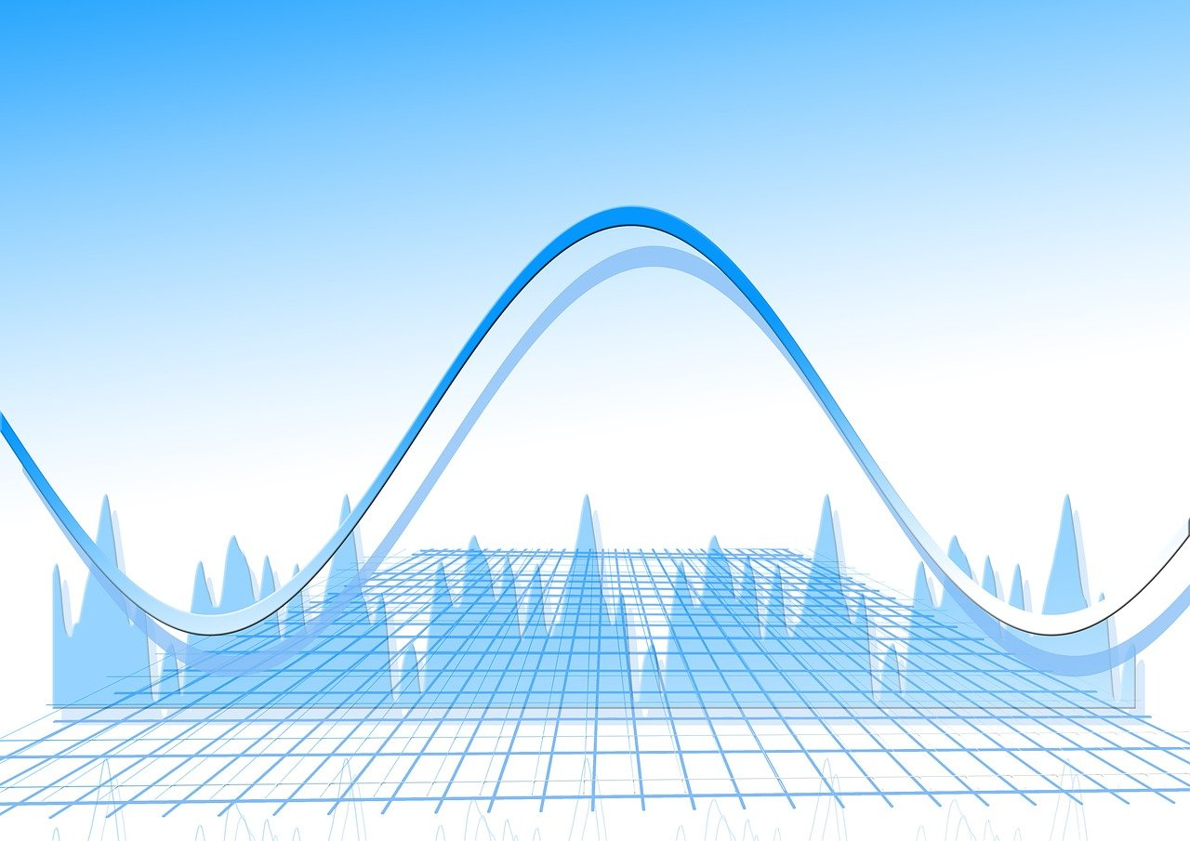


Parameter & Statistics
PARAMETER: This is a measure that describes a characteristic of an entire population. Examples include the population mean (μ), population variance (σ²), and population standard deviation (σ). Parameters are typically fixed values but are often unknown because it's impractical or impossible to measure an entire population.
STATISTICS: This is a measure that describes a characteristic of a sample taken from a population. Examples include the sample mean (x̄), sample variance (s²), and sample standard deviation (s). Statistics are used to estimate population parameters and are calculated from data collected from a sample. They can vary from sample to sample.

Slide 57

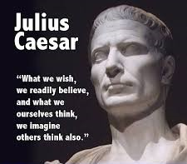
Parameter & Statistics
Roman- Sample Statistics
Mean: xˉ
Variance: s2
Standard Deviation: s
Greek –Papulation Parameter
Mean: µ
Variance: σ2
Standard Deviation: α

Slide 58
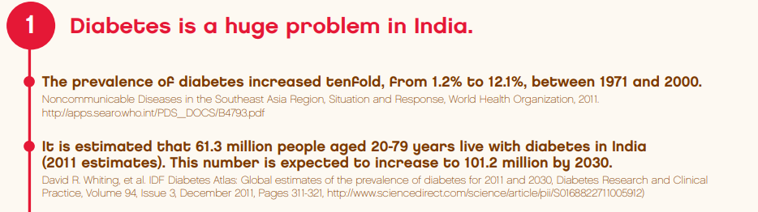
Descriptive Statistics – Data gathered about a group to reach conclusions about the same group.
• Inferential Statistics – Data gathered from a sample and the statistics generated to reach conclusions about the population from which the sample is taken. Also known as Inductive Statistics
Descriptive and Inferential Statistics

Slide 59
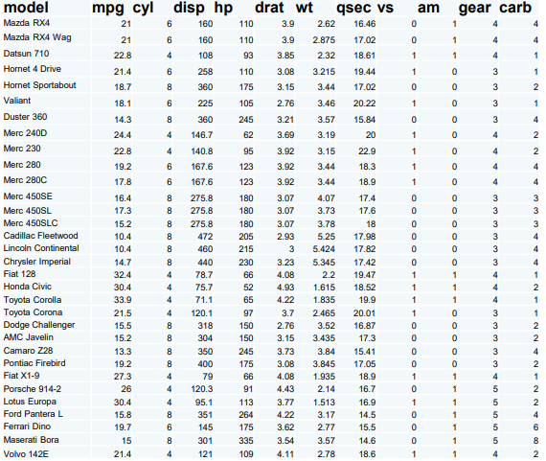
Variables and Data

Slide 60
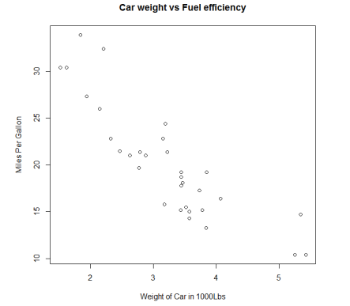
Variables – Dependent and Independent
• Dependent variables on y-axis and Independent on x-axis.
• Dependent variable also called Target variable or Class variable.

Slide 61



Data – Numeric and Categorical
18 kg
27 kg

Slide 62

Categorical Data (Qualitative)
Ordinal Examples
• Mutual fund risk ratings
• Fortune 50 rankings
• Movie ratings
Nominal Examples
Employee ID
Gender
Religion
Ethnicity
Pin codes
Place of birth
Aadhaar numbers
While there is an order, difference between consecutive levels are not always equal.

Slide 63

Quantitative Data - Interval
Data where ordering is clear and the difference in data values is meaningful.
However, there is no natural zero or origin. So ratios are not meaningful.
Example: Year 1008 vs 2016 Temperature: 14C vs 28C

Slide 64

Quantitative Data - Ratio
Ratio level data is similar to Interval level data, with the key difference – there is a natural zero point.
Examples: Weights, Cost of things, Number of correct answers in a exam

Slide 65

Summary of Levels of Data Measurement
•Nominal - Categories only
•Ordinal - Categories with some order
•Interval – Meaningful differences, but no zero point
•Ratio – Meaningful differences with a natural starting point

Slide 66
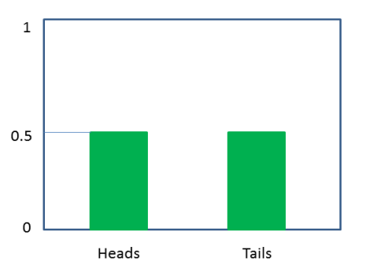
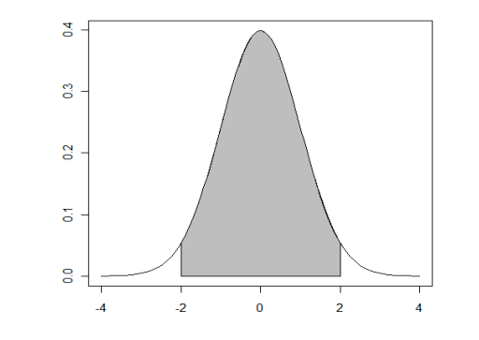
Discrete and Continuous
Countable
Measurable

Slide 67

Time between customer arrivals at a retail outlet Continuous
Sampling the volume of liquid nitrogen in a storage tank Continuous
Sampling 100 voters in an exit poll and determining how many voted for the winning candidate Discrete
Lengths of newly designed automobiles Continuous
No. of customers arriving at a retail outlet during a five-minute period Discrete
No. of defects in a batch of 50 items Discrete
Discrete or Continuous?

Slide 68
DESCRIBING DATA THROUGH STATISTICS

Slide 69



The Central Tendencies
Sai wants to join a health club in an activity that has others in the same age group as him. He is 22 years old. Mean ages for Yoga, Power Workout and Swimming classes are:
15 years
20 years
17 years

Slide 70

The Central Tendencies
Yoga class composition
Age (years) | 13 | 15 | 17
Frequency, f | 1 | 3 | 2
Mean,
Σ𝑓𝑥
μ= n∑/n = = 1∗13 + 3∗15 + 2∗17
Σ𝑓
= 15.3
1+3+2

Slide 71


The Central Tendencies
Power workout class composition
Age (years) | 13 | 15 | 17 | 90
Frequency, f | 4 | 6 | 3 | 1
Mean,
Σ𝑓𝑥
μ= ∑x/n = = 4∗13 + 6∗15 + 3∗17+1 ∗90
Σ𝑓
= 15.3
4+6+3+1
But nobody in Sai’s age group .

Slide 72
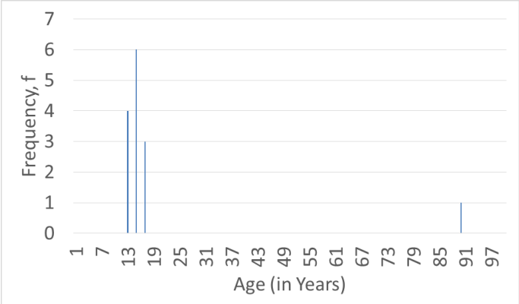
The Central Tendencies
Power workout class composition
Age (years) | 13 | 15 | 17 | 90
Frequency, f | 4 | 6 | 3 | 1

Slide 73
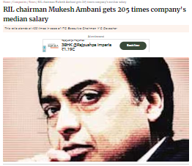
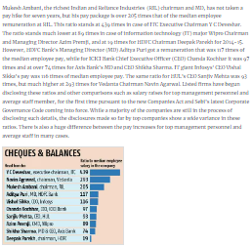
The Central Tendencies

Slide 74
Power workout class composition
Age (years) | 13 | 15 | 17 | 90
Frequency, f | 4 | 6 | 3 | 1
The Central Tendencies
Data has outliers Median – the mid-point 13, 13, 13, 13, 15, 15, 15, 15, 15, 15, 17, 17, 17, 90

Slide 75
The Central Tendencies
Survival by Stage
Doctors use a four-stage system to describe the progression of cancer within the body. Patients diagnosed at stage I have the most favorable outlook, while those diagnosed at stage IV face the most challenging prognosis.
Median
Month

Slide 76
The Central Tendencies
Sai is feeling unsettled and seeks some relaxation by joining a swimming class. However, he is puzzled when asked about the whereabouts of his child.
Age (years) | 1 | 2 | 3 | 30 | 31 | 32 | 33
Frequency, f | 3 | 4 | 3 | 1 | 3 | 2 | 4
Mean ~ 17 years
Median?
What happens to Median if another kid or adult is added?

Slide 77
The Central Tendencies
Age (years) | 1 | 2 | 3 | 30 | 31 | 32 | 33
Frequency, f | 3 | 4 | 3 | 1 | 3 | 2 | 4
*What is the Mode – the most frequently occurring data point?
The mode is the value that appears most frequently in a dataset. It represents the most common data point among all values.
The mode is the only measure of central tendency that can be used with categorical data.

Slide 78
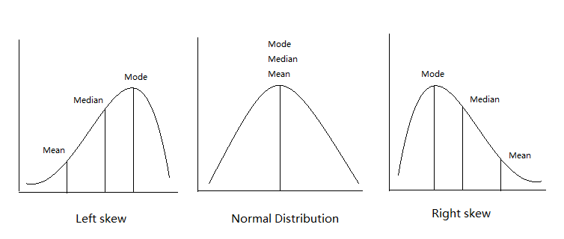
The Central Tendencies

Slide 79

The Central Tendencies
Good Heart Inc. is deciding how to give its employees a raise. They are considering either giving everyone a flat Rs 2000 increase or raising all salaries by 10%. Currently, the average salary is Rs 50,000, the median salary is Rs 20,000, and the most common salary is Rs 10,000.
How do these central tendencies change in both cases?

Slide 80
Measuring Variability and Spread
Basketball coach Stason is struggling to choose between three players who all have the same average scores.
Points scored per game | 7 | 8 | 9 | 10 | 11 | 12 | 13
Frequency, f | 1 | 1 | 2 | 2 | 2 | 1 | 1
Points scored per game | 7 | 9 | 10 | 11 | 13
Frequency, f | 1 | 2 | 4 | 2 | 1
Points scored per game | 3 | 6 | 7 | 10 | 11 | 13 | 30
Frequency, f | 2 | 1 | 2 | 3 | 1 | 1 | 1
Mean = Median = Mode = 10 for all 3.

Slide 81
Measuring Variability and Spread
Range = Max - Min
Points scored per game | 7 | 8 | 9 | 10 | 11 | 12 | 13
Frequency, f | 1 | 1 | 2 | 2 | 2 | 1 | 1
Points scored per game | 7 | 9 | 10 | 11 | 13
Frequency, f | 1 | 2 | 4 | 2 | 1
Points scored per game | 3 | 6 | 7 | 10 | 11 | 13 | 30
Frequency, f | 2 | 1 | 2 | 3 | 1 | 1 | 1

Slide 82
Measuring Variability and Spread
Exclude outliers scientifically – Quartiles
Points scored per game | 3 | 6 | 7 | 10 | 11 | 13 | 30
Frequency, f | 2 | 1 | 2 | 3 | 1 | 1 | 1
3 3 6 7 7 10 10 10 11 13 30
Median = 10
3 3 6 7 7 10
First Quartile
= 6.5
10 10 10 11 13 30
Third Quartile = 10.5

Slide 83
Quartiles
Quartiles: Division of a dataset into four equal parts. For n data points, the quartile boundaries are determined by the following formulas:
1∗(𝑛−1)
Lower quartile (25th percentile, Q1) =
+ 1
th
4
2∗(𝑛−1)
(𝑛+1)
+ 1
th
th
Middle quartile = Median =
4
=
2
3∗(𝑛−1)
Upper quartile (75th percentile, Q3) =
+ 1
th
4
Interquartile range, IQR = Q3-Q1 (central 50% of data)

Slide 84
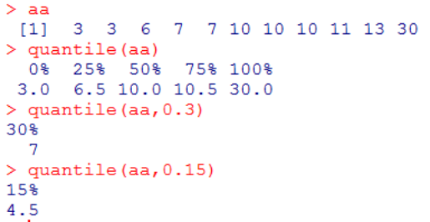
Percentiles
•
Percentile: divide the data set into 100 regions
P∗(𝑛−1)
•
P th percentile =
+ 1
th
4

Slide 85
Box-Whisker Plot
The Box and Whisker plot allows you to visualize the spread in the data easily
Steps
– Compute the Q1, Median and Q3 for the data. Compute IQR=Q3-Q1
– The Box of the plot is drawn from Q3 to Q1 (50% of data is contained within the box)
– The Whiskers are a maximum of 1.5*IQR from the top and the bottom of the box.
– If there are no data points at 1.5*IQR, then pick an actual data point within the range of the Whiskers
– Points lying outside the 1.5*IQR from the box ends are considered as Outliers.

Slide 86
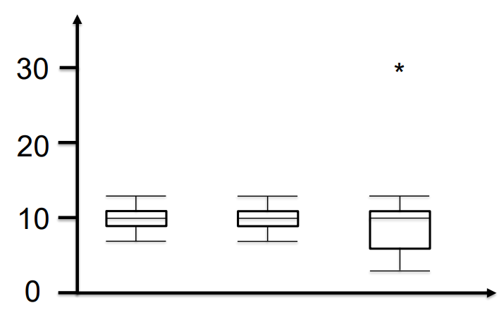
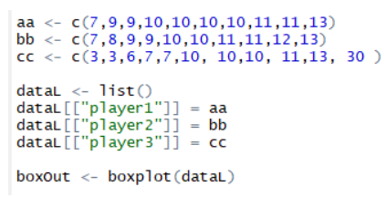
Measuring Variability and Spread
Exclude outliers scientifically – Quartiles
Box and whisker diagram or Box plot

Slide 87
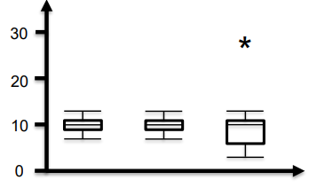
Measuring Variability and Spread
Exclude outliers scientifically – Quartiles Box and whisker diagram or Box plot
NAME | FORMULA | PLAYER 1 | PLAYER 2 | PLAYER 3
Lower Hing | Q1=1st Quartile | 9 | 9 | 6.5
Midline | Q2 =2nd Quartile = Median | 10 | 10 | 10
Upper Hinge | Q3 =3rd Quartile | 11 | 11 | 10.5
Body of the box | IQR = Q1 - Q3 | 2 | 2 | 4
step | 1.5*IQR | 3 | 3 | 6
 | Lower Hinge - 1 Step | 6 | 6 | 0.5
 | Upper Hinge + 1 step | 14 | 14 | 16.5
Lower fence | smallest Actual Data Inside Fence | 7 | 7 | 3
Upper Fence | Largest Actual Data Inside Fence | 13 | 13 | 13
Outliers | Value beyond the Fence |  |  | 30

Slide 88
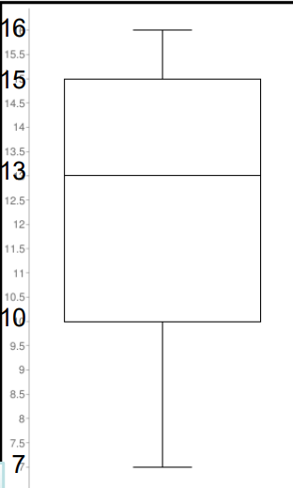
Interpreting Box-whiskers plot
Age of kids in a party
Which of the following statements are true?
• All of the students are less than 17 years old
• At least 75% of the students are 10 years old or olde
r • There is only one 16-year-old at the party
• The youngest kid is 7 years old
• Exactly half the kids are older than 13
True
True
Can’t Say
True
Can’t Say

Slide 89
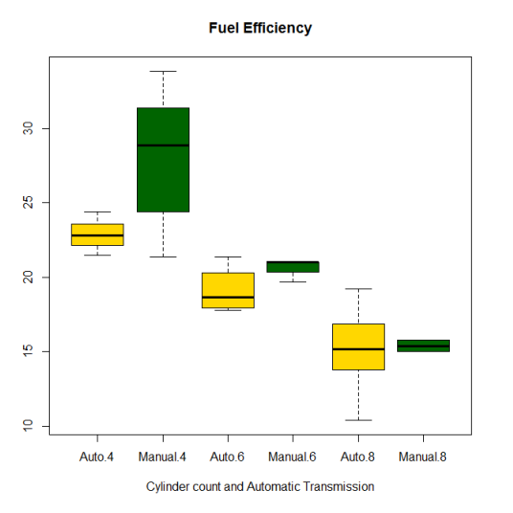
Fuel Efficiency vs (Transmission/ Cylinder count)

Slide 90


Outlier detection – Excel and Box Plot Steps
Hadlum vs Hadlum case
I tell you Watson there is something fishy going on here...

Slide 91
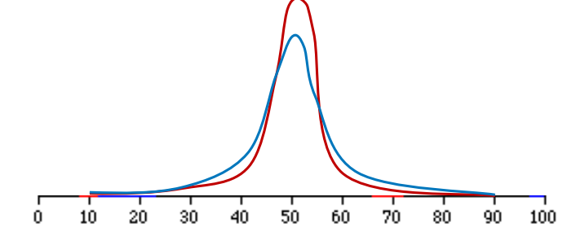
Measuring Variability and Spread
Range and IQR give the spread but still do not describe variability (consistency).
Average distance from the mean?
3 3 6 7 7 10 10 10 11 13 30

Slide 92
Average Distance from Mean
Consider the dataset
2, 2, 4, 4
Mean, 𝜇 =3
-1
𝜇
1
1
2
3
4
5
Average distance of all points from the mean = 0
We need to measure unsigned distance. Two choices - absolute values or consider squared distances

Slide 93
Mean Absolute Distance (MAD) from µ
Consider the dataset
1,1,4,6
Mean, 𝜇 =3
|1-3|+|1-3|+|4-3|+|6-3|
MAD
=
4
8
MAD
=
=
2
4
Average distance of each point from the mean is 2

Slide 94
Consider the dataset
1,1,4,6
Mean, 𝜇 =3
Σ(𝑥−𝜇)2
(1−3)2 + (1−3)2+ (4−3)2+ (6−3)2
Root Mean Squared Distance from µ
M.S.D=
n
=
4
M.S.D=
18
=
4.5
Variance σ2
4
Standard Deviation σ
RMSD = 4.5 = 2.12
Standard deviation penalizes farther points more than M.A.D

Slide 95
Measuring Variability & Spread
• Both Mean Absolute Distance and Standard Deviation/Variance are valid metrics to measure the spread/variability in the data
• Standard Deviation is more commonly used

Slide 96
Measuring Variability and Spread
Σ(𝑥−𝜇) 2
Σ𝑥 2
Variance =
=
− 𝜇 2
(Derive)
n
n
3 3 6 7 7 10 10 10 11 13 30
Units are squared, which is not intuitive.
Standard Deviation, 𝜎 = 𝑉𝑎𝑟𝑖𝑎𝑛𝑐

Slide 97



Measuring Variability and Spread
Calculate standard deviation for each player.
Points scored per game | 7 | 8 | 9 | 10 | 11 | 12 | 13
Frequency, f | 1 | 1 | 2 | 2 | 2 | 1 | 1
Points scored per game | 7 | 9 | 10 | 11 | 13
Frequency, f | 1 | 2 | 4 | 2 | 1
Points scored per game | 3 | 6 | 7 | 10 | 11 | 13 | 30
Frequency, f | 2 | 1 | 2 | 3 | 1 | 1 | 1
1.73, 1.48, 7.02
Player 3 is the least reliable.

Slide 98

Measuring Variability and Spread
What happens to Standard Deviation if Good Heart Inc. gave all employees a Rs 2000 raise?
What happens to Standard Deviation if Good Heart Inc. gave all employees a 10% raise?
No change.
Increases by 1.1 times.

Slide 99

Measuring Variability and Spread
Imagine 2 players with different abilities: one has an average of 80% with 12% Stdev and the other 40% with 20% Stdev.
In a particular practice session, the first one scores 90% of the time and the second 55%. Who did best against their PERSONAL track record?

Slide 100


Measuring Variability and Spread
𝑥−𝜇
Standard score, 𝑧 =
# of stdevs from the mean
𝜎 ‘

Slide 101

Measuring Variability and Spread
Property | Value
Mean of x in each case | 9 (exact)
Sample variance of x in each case | 11 (exact)
Mean of y in each case | 7.50 (to 2 decimal places)
Sample variance of y in each case | 4.122 or 4.127 (to 3 decimal places)
Correlation between x and y in each case | 0.816 (to 3 decimal places)
Linear regression line in each case | y = 3.00 + 0.500x (to 2 and 3 decimal places, respectively)
Anscombe's quartet
I |  | II |  | III |  | IV
x | y | x | y | x | y | x | y
10 | 8.04 | 10 | 9.1 | 10 | 7.46 | 8 | 6.6
8 | 6.95 | 8 | 8.1 | 8 | 6.77 | 8 | 5.8
13 | 7.58 | 13 | 8.7 | 13 | 12.7 | 8 | 7.7
9 | 8.81 | 9 | 8.8 | 9 | 7.11 | 8 | 8.8
11 | 8.33 | 11 | 9.3 | 11 | 7.81 | 8 | 8.5
14 | 9.96 | 14 | 8.1 | 14 | 8.84 | 8 | 8.5
6 | 7.24 | 6 | 6.1 | 6 | 6.08 | 8 | 5.3
4 | 4.26 | 4 | 3.1 | 4 | 5.39 | 19 | 13
12 | 10.08 | 12 | 9.1 | 12 | 8.15 | 8 | 5.6
7 | 4.82 | 7 | 7.3 | 7 | 6.42 | 8 | 7.9
5 | 5.68 | 5 | 4.7 | 5 | 5.73 | 8 | 6.9

Slide 102

PROBABILITY BASICS

Slide 103

Understanding Probability
Consider the following statements. How do you interpret “probability” in each one of those? And how is it computed?
• Coin Toss – Probability of Head is ½
• Weather – Probability of thunderstorm tomorrow is 25%
• Cricket– CSK will have less than 25% chance of winning this IPL if Chennai matches get moved to Pune.

Slide 104

Probability vs Statistics
• Probability – Predict the likelihood of a future event
• Statistics – Analyze the past events
Questions addressed –
• Probability – What will happen in each ideal world?
• Statistics – How ideal is the world?

Slide 105

Probability - Applications
Insurance industry uses probabilities in actuarial tables for setting premiums and coverages.

Slide 106
Probability - Applications
Life experience of birth( years)
<12
12
13-15
16or more
Years of education

Slide 107

Probability - Applications
• Gaming industry – Establish charges and payoffs
• Manufacturing/Aerospace – Prevent major breakdowns
• Business – Deciding on a business proposal based on probability of success vs cost
• Risk Evaluation – Scenario analysis

Slide 108

Assigning Probabilities
Classical Method – A priori or Theoretical Probability can be determined prior to conducting any experiment.
# 𝑜𝑓 𝑜𝑢𝑡𝑐𝑜𝑚𝑒𝑠 𝑖𝑛 𝑤ℎ𝑖𝑐ℎ 𝑡ℎ𝑒 𝑒𝑣𝑒𝑛𝑡 𝑜𝑐𝑐𝑢𝑟
𝑃 (𝐸) =
𝑡𝑜𝑡𝑎𝑙 𝑝𝑜𝑠𝑠𝑖𝑏𝑙𝑒 # 𝑜𝑓 𝑜𝑢𝑡𝑐𝑜𝑚𝑒
Example: Tossing of a fair die

Slide 109

Assigning Probabilities
What is the probability of a baby being born on a Wednesday?
A-priori probability 1/7 = 14.3%
Data from “Risks of Stillbirth and Early Neonatal Death by Day of Week”, by Zhong-Cheng Luo, Shiliang Liu, Russell Wilkins, and Michael S. Kramer, for the Fetal and Infant Health Study Group of the Canadian Perinatal Surveillance System. Data of 3,239,972 births in Canada between 1985 and 1998. The reported percentages do not add up to 100% due to rounding.

Slide 110
Assigning Probabilities
Empirical Method – A posteriori or Frequentist Probability can be determined post conducting a thought experiment.
# 𝑜𝑓 𝑡𝑖𝑚𝑒𝑠 𝑎𝑛 𝑒𝑣𝑒𝑛𝑡 𝑜𝑐𝑐𝑢𝑟𝑟𝑒
𝑃 (𝐸) =
𝑡𝑜𝑡𝑎𝑙 # 𝑜𝑓 𝑜𝑝𝑝𝑜𝑟𝑡𝑢𝑛𝑖𝑡𝑖𝑒𝑠 𝑓𝑜𝑟 𝑡ℎ𝑒 𝑒𝑣𝑒𝑛𝑡 𝑡𝑜 ℎ𝑎𝑣𝑒 𝑜𝑐𝑐𝑢𝑟𝑟𝑒�
Example: Tossing of a weighted die…well!, even a fair die. The larger the number of experiments, the better the approximation. This is the most used method in statistical inference.

Slide 111

Assigning Probabilities
Empirical Method – A posteriori or Frequentist 100 calls handled by an agent at a call center
64
36
0
20
40
60
80

Slide 112
Assigning Probabilities
Empirical Method – A posteriori or Frequentist 100 calls handled by an agent at a call center
72
28
0
20
40
60
80

Slide 113
Assigning Probabilities
Empirical Method – A posteriori or Frequentist 100 calls handled by an agent at a call center
136
64
0
20
40
60
80
P(easy) = 0.7

Slide 114
Assigning Probabilities
What is the probability of TDP, DMK and Mamta Banerjee led Third front in making an impact on the upcoming Lok Sabha elections?
Subjective Method Based on feelings, insights, knowledge, etc. of a person.

Slide 115

Assigning Probabilities
Subjective Method 2010 rates of growth in US GDP anticipated by 56 economists at the start of 2010. Data from: http://projects.wsj.com/econforecast/#ind=gdpa&r=10&e=75 and http://data.worldbank.org/indicator/NY.GDP.MKTP.KD.ZG Does it mean probability of GDP growing by more than 4% is 6/56 = 0.11?
Frequency
Actual growth 2.5%

